Slide 1

Detecting AI-Generated Arabic Abstracts
MSIS-822 Project
Abdulaziz Owaidh Alsehli (ID: 4714237)
Taibah University

Slide 2
Abstract
Large language models can now write Arabic text that looks very close to human writing. This creates problems in universities and online platforms because it becomes difficult to know if a piece of text was written by a student or
generated by an AI tool. In this project, we build a binary classifier that decides whether an Arabic abstract is human- written or AI-generated. We use a unified dataset of 41,940 abstracts and apply a dedicated preprocessing pipeline for
Arabic, including diacritic removal, normalization, stopword removal, and stemming. Sentence-transformer embeddings are extracted and used as features for several models: Logistic Regression, Support Vector Machine, Random Forest, XGBoost,

Slide 3
Introduction
Generative language models such as GPT-based systems, LLaMA, and other transformer models are now
abstracts and short articles that look very similar to human academic writing. This situation raises

Slide 4
Dataset
Dataset: KFUPM-JRCAI Arabic generated abstracts.
Total samples: 41,940 abstracts (human-written and AI-generated).
Labels: created = 0 (human), created = 1 (AI-generated).
Data stored in original_data.xlsx and clean_data.xlsx for inspection.

Slide 5
Methodology – Overview
Arabic-specific preprocessing: normalization, diacritics removal, stopword removal, tokenization.
Sentence-transformer embeddings used to represent each abstract as a dense vector.
Hand-crafted stylometric features (length, punctuation, vocabulary richness, etc.).

Slide 6
Methodology – Stylometric Features
Feature 12 – short-word ratio (very short words / total words).
Feature 35 – number of paragraphs in each abstract.
Feature 58 – count of words among the top-100 most frequent words.
Feature 81 – language-model-based log-likelihood score (LogRank).
Feature 104 – frequency of specific Arabic root patterns.

Slide 7
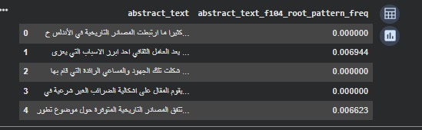
Methodology – Stylometric Features

Slide 8
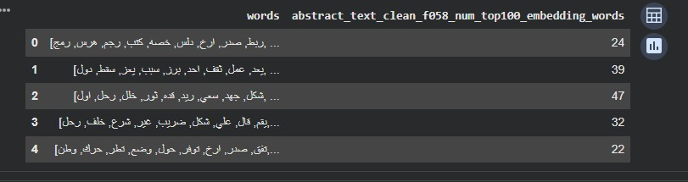
Methodology – Stylometric Features

Slide 9
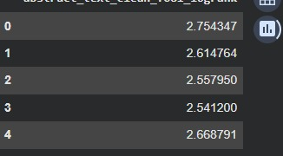
Methodology – Stylometric Features

Slide 10
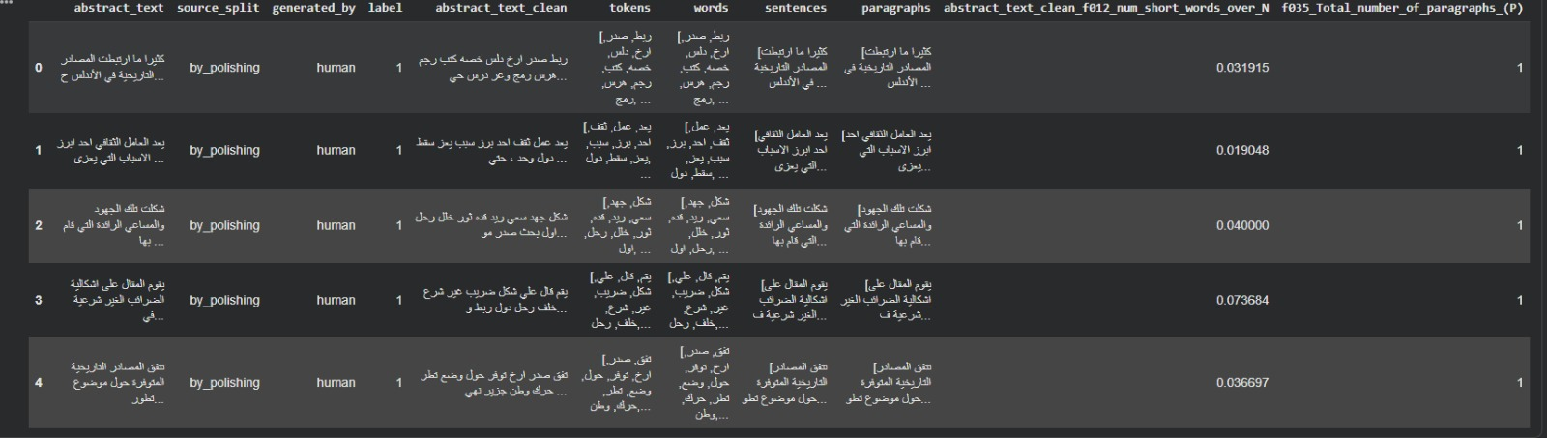
Methodology – Stylometric Features

Slide 11
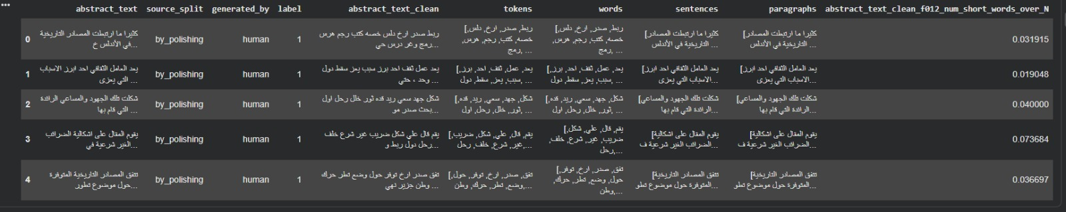
Methodology – Stylometric Features

Slide 12
Models
Classical models: Logistic Regression, Support Vector Machine (SVM), Random Forest, XGBoost.
Neural model: Feedforward Neural Network (FFNN) on top of transformer embeddings.
Models trained on the same feature set for a fair comparison.

Slide 13
Results – Overall Performance
Random Forest achieves the best overall performance (Accuracy ≈ 0.9793, F1 ≈ 0.9497).
SVM and XGBoost also perform strongly with accuracy above 0.97.
Logistic Regression is slightly weaker but still above 0.96 accuracy.
FFNN performs noticeably worse (Accuracy ≈ 0.8774, F1 ≈ 0.6854).

Slide 14
Discussion
Classical models on top of transformer embeddings are very strong for this task.
Random Forest benefits from non-linear decision boundaries and feature interactions.
FFNN underperforms, likely due to limited tuning and model capacity.
Class imbalance (more AI-generated than human abstracts) affects recall for the minority class.

Slide 15
Conclusion & Future Work
It is feasible to detect AI-generated Arabic abstracts with high accuracy.
Random Forest, SVM and XGBoost achieve strong performance on this dataset.
Stylometric features and transformer embeddings complement each other.
Future work: address class imbalance and explore fine-tuned transformer classifiers.

